Slide 1
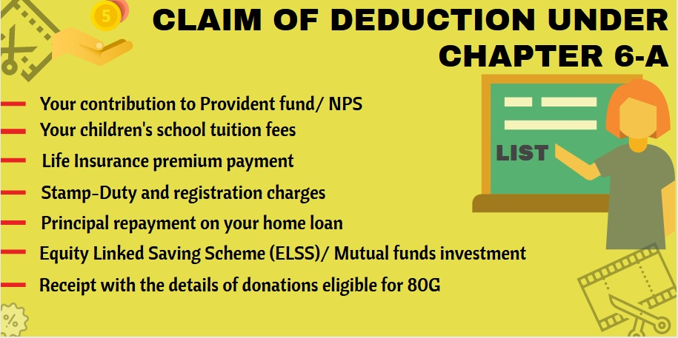
Deduction under chapter vi a

Slide 2
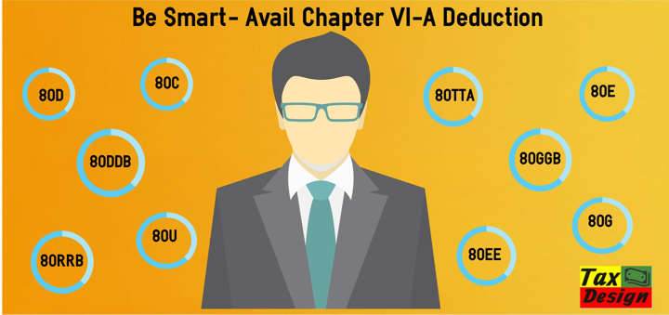
INTRODUCTION
Chapter VI A of Income Tax Act contains various sub-sections of section 80 that allows an assessee to claim deductions from the gross total income on account of various tax-saving investments, permitted expenditures, donations etc. Such deductions allow an assessee to considerably reduce the tax payable.

Slide 3

Relevant provisions in this regard are as follows:
(1) In computing the total income of the assessee, there
shall be allowed from the gross total income, deductions as specified under chapter VI-A. These deductions are enumerated u/s 80C to 80U.
(2 The aggregate amount of deductions under
chapter VI-A shall in no case exceed the amount of gross total income of the
assessee.
(3) No deduction under chapter VI-A shall be permitted if the gross total income is
NEGATIVE or NI

Slide 4

Incomes from which deductions under chapter VI-A cannot be claimed
(a) Long-term Capital Gains (LTCG);
(b) Short-term Capital Gains (STCG) covered u/s 111A;
(c) Winnings Income;
(d) Unexplained Monies & Investments u/s 115BBE

Slide 5

Section 80D – Tax Deductions for Medical Insurance Premium

Slide 6
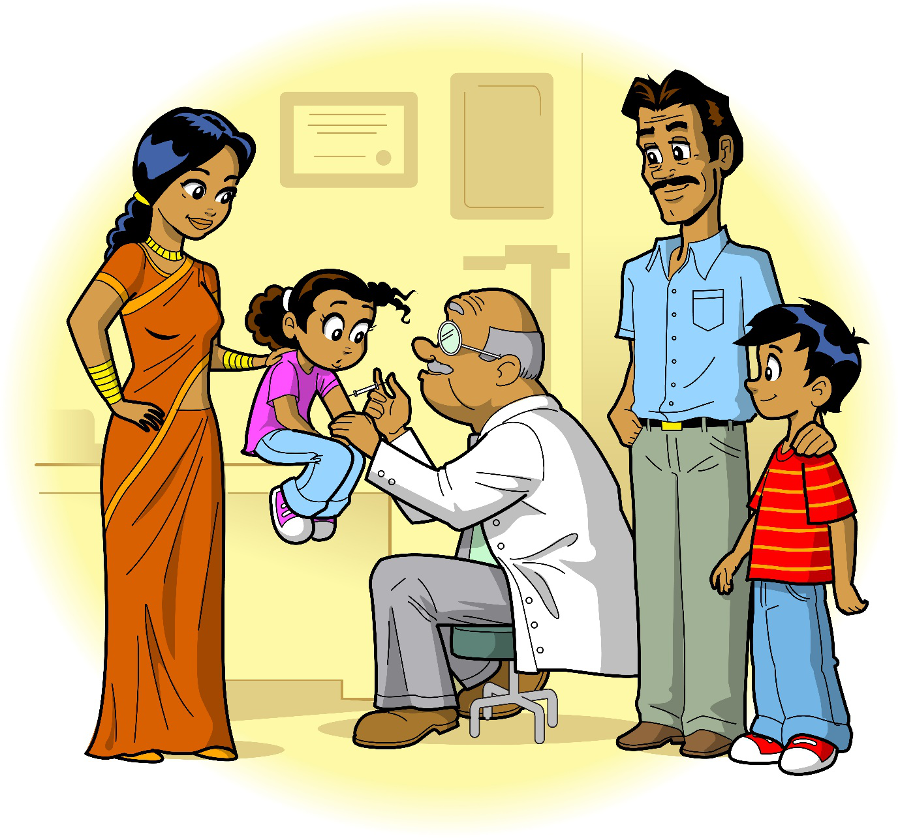
Section 80D of the income tax allows individuals and HUFs (Hindu Undivided Family. The medical expenditure includes:
Medical insurance premium
Medical expenditure
Preventive health checkup
Deduction for medical expenses paid for the
following:
Self
Spouse
Children
Parents

Slide 7
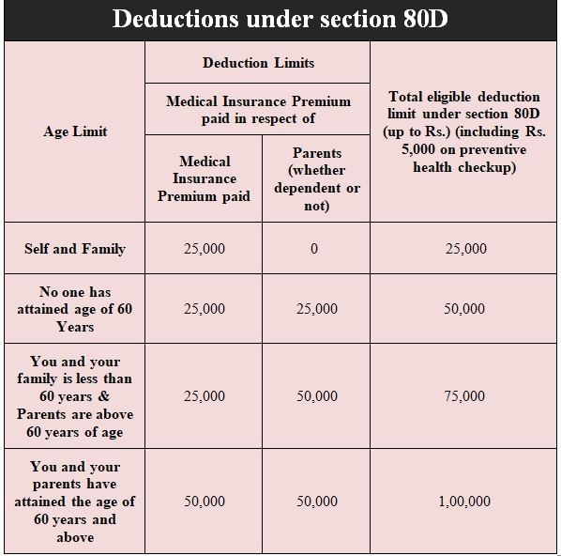
80D: Deduction in respect of Health Insurance premium. Premium paid up to Rs 25,000 is eligible for deduction for individuals, other than senior citizens. For senior citizens, the limit is Rs 50,000 and overall limit u/s 80D is Rs 1 lakh.

Slide 8

Deduction under section 80DD

Slide 9

Deduction under section 80DD
Deduction under section 80DD of the income tax act is allowed to Resident Individuals or HUFs for a dependant-who is differently-abled and– is wholly dependent on the individual (or HUF) for support & maintenance.
Below are the conditions you must meet to avail this deduction –
Deduction is allowed for a dependant of the taxpayer and not the taxpayer himself.

Slide 10
The taxpayer is not allowed this deduction if the dependent has claimed a deduction under section 80U for himself/herself.
• Deduction of 1, 25,000 (revised from 1, 00,000) is allowed in case of severe disability (more than 80%)
• Deduction of Rs 75,000 (revised from limit of 50,000) is allowed in case of disability (more than 40% but less than 80%)

Slide 11

DEDUCTION UNDER SECTION 80E

Slide 12

According to Section 80E the deduction is allowed on the total interest amount of the EMI paid during the financial year. The loan has to be taken from a bank or financial institution for the purpose of pursuing higher studies.

Slide 13
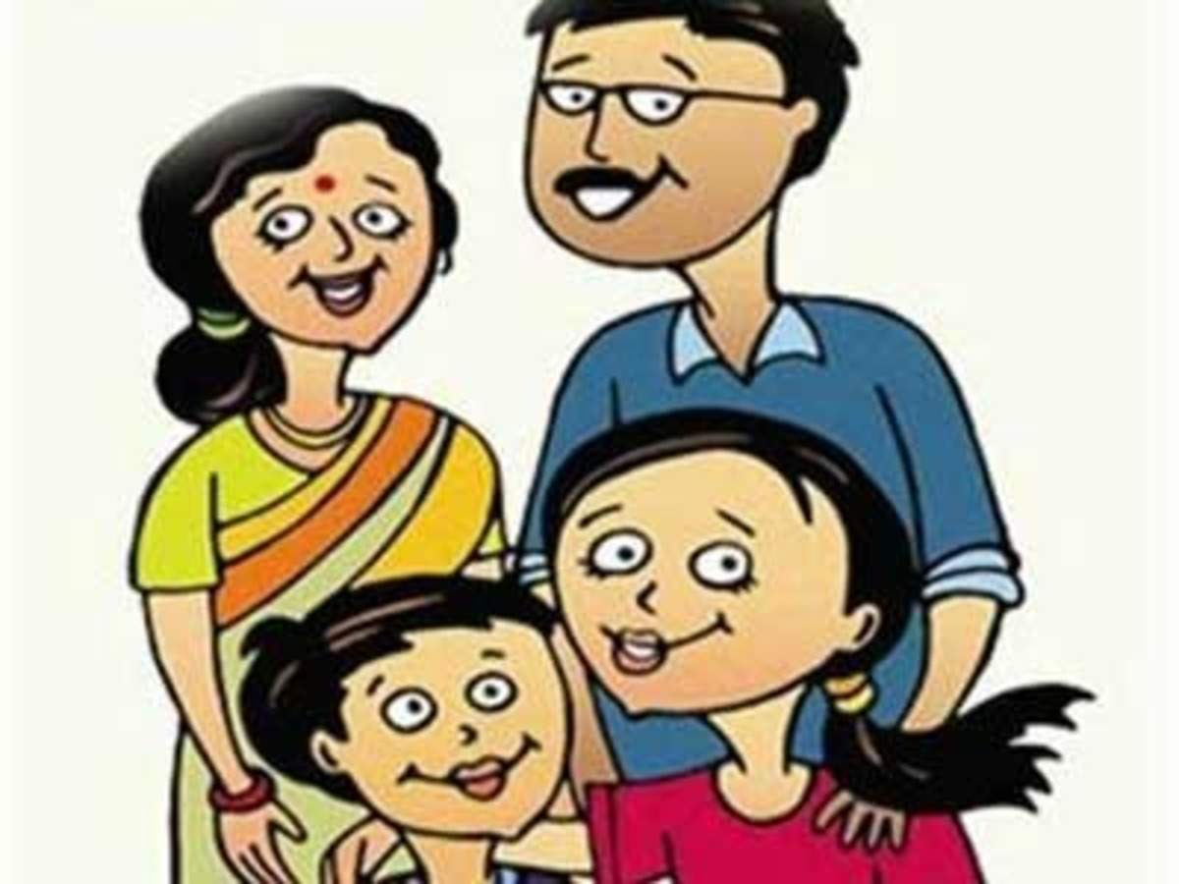
Who can claim this deduction?
Only an individual can claim this deduction. It is not available to HUF or any other kind of taxpayer.
The loan should be taken for the higher education of self, spouse or children or for a student for whom the individual is a legal guardian.
Parents can easily claim this deduction for the loan taken for the higher studies of their children.

Slide 14

There is no maximum limit for claiming tax deductions on interest paid for education loans. But you can only claim education loan tax savings or tax deductions for a maximum of 8 years.
Types of education loans eligible for tax deductions.
You can take education loan tax benefits on courses enrolled by you, your spouse and children. Whether you have taken an education loan for a course in India or abroad, you can claim tax deductions on such loans in India. The only condition is that the loan should be taken from a financial institution approved by the RBI.

Slide 15
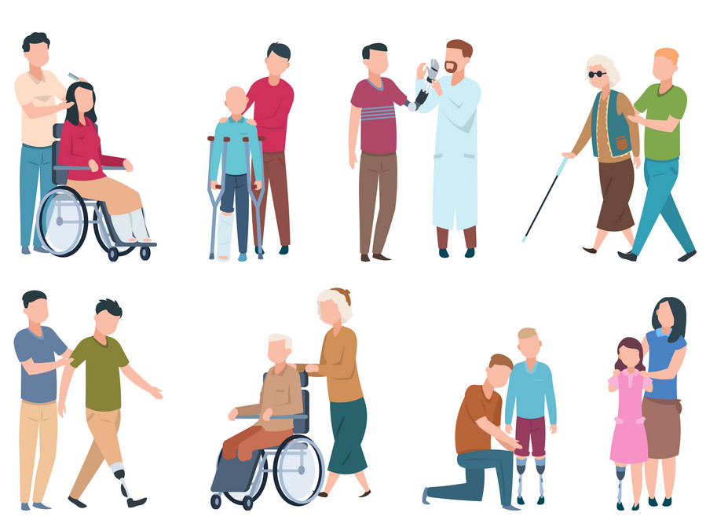
DEDUCTION UNDER SECTION 80E

Slide 16
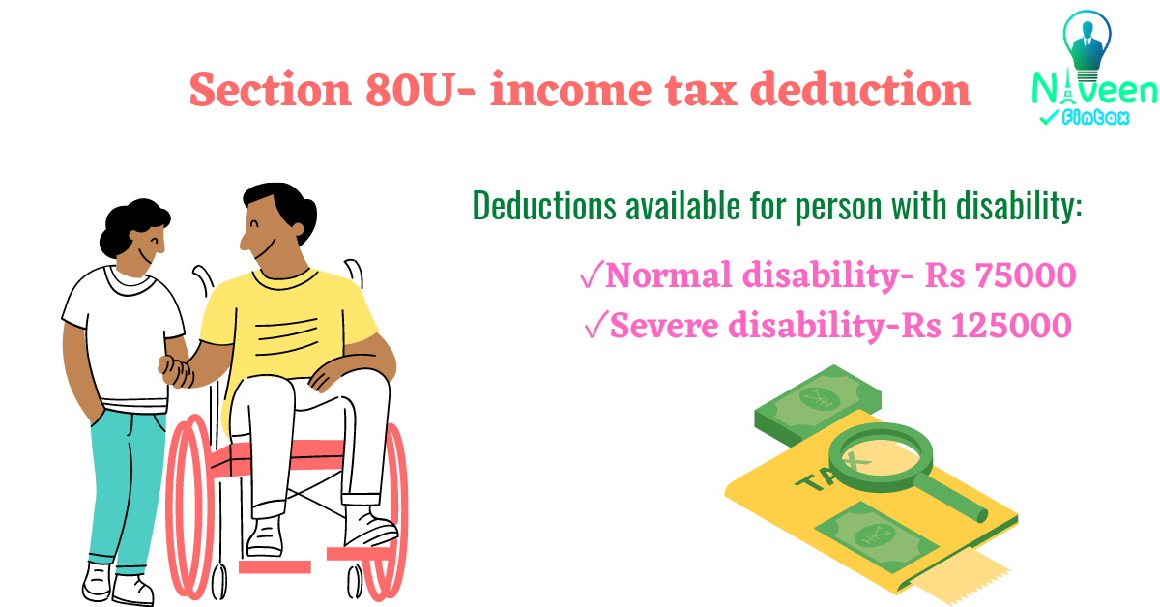
Any person who has been an Indian resident for the year of assessment and has suffered from at least 40 percent disability as spelt out by the law, qualifies for tax deductions under Income Tax Act 1961.
People can claim deduction under section 80C who are suffering from disability at least 40%, they can claim a tax deduction up to Rs.75000 on your income and Rs. 1,25,000 deduction for people with severe disability

Slide 17
Who Can Claim Deduction Under Section 80U
A resident individual who has been certified as a person with a disability by the medical authority can claim the tax benefit under Section 80U. For the purpose of this section, disability has been defined as one of the following:
Blindness
Low vision
Leprosy-cured
Hearing impairment
Loco motor disability
Mental retardation
Mental illness

Slide 18


